Slide 1
Condition – Fulton’s K

Slide 2
Length Weight Data
US Bottom Trawl (Spring and Fall) and DFO (Spring).
Post-spawning fish only?
Separate male and female.
No restrictions on statistical areas (i.e. not intersect of strata and area); only strata assigned as discussed in RT.

Slide 3
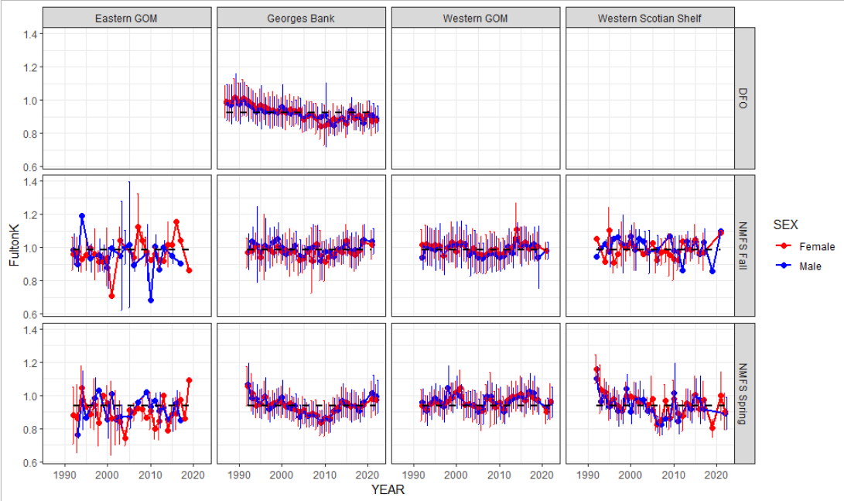

Slide 4
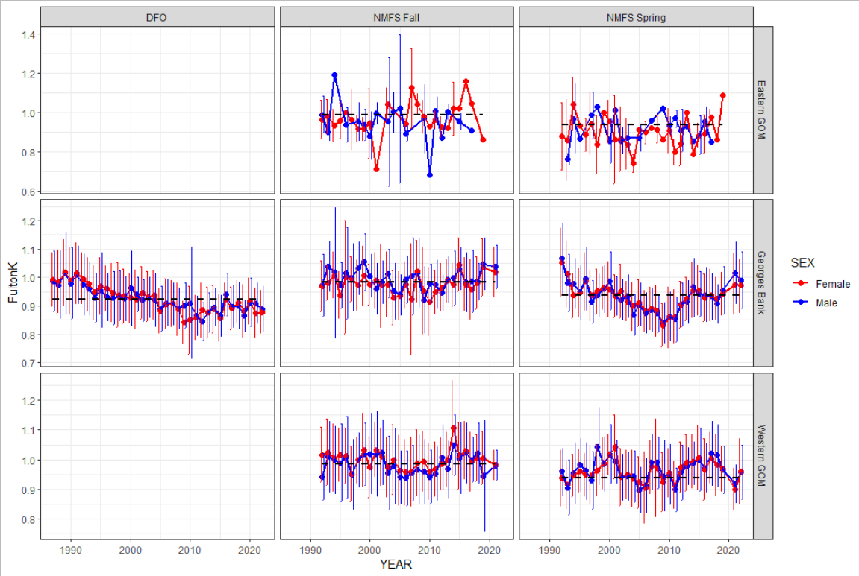

Slide 5
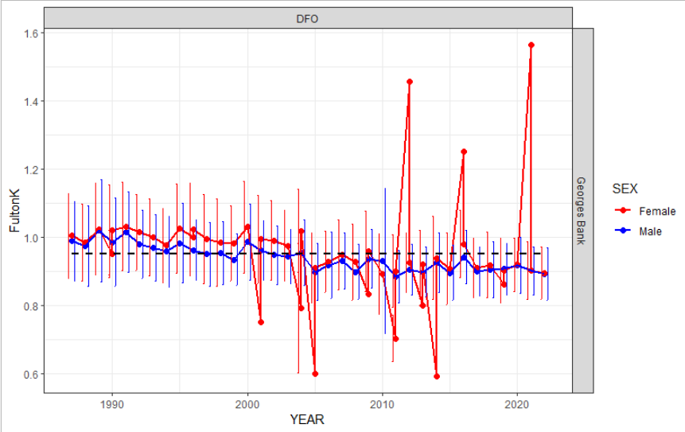
Length Weight Data
US Bottom Trawl (Spring and Fall) and DFO (Spring).
Post-spawning fish only? Not a good idea (see DFO plot) but if someone insists on seeing it, I’ll need help with US codes…
Separate male and female…? Not much difference in trend between sexes for post-spawning plots.
No restrictions on statistical areas (i.e. not intersect of strata and area); only strata assigned as discussed in RT. Could align with Statistical Area lines, but would be inconsistent with Charles’ work, which uses strata only.

